Slide 1

Hand Drawn Circuit Symbol Detection Using Deep Learning
UNDER THE GUIDANCE OF:
Dr. K Indira
PROFESSOR
DEPARTMENT OF ELECTRONICS AND COMMUNICATION
RAMAIAH INSTITUTE OF TECHNOLOGY
Team Members:
Devesh Shukla 1MS17EC022
Suyash Bhadani 1MS17EC116
Ranbir Singh 1MS17EC084
Nitin S 1MS17EC065

Slide 2
INTRODUCTION
Human computer interaction is one area which has a lot of boom and attention these days.
It provides a possibility for a computer to see and analyze and conclude a result like a human.
If a machine could recognize what a human write, it would be a value add and could lead to more innovations and inventions.
Considering this aspect, we are working on creating an application for recognizing the electronic components present in a circuit drawn by the user by hand in a paper.

Slide 3
OBJECTIVES
A standardization algorithm for the purpose of cleaning hand drawn images.
A generalized preprocessing pipeline that provides extra accuracy to the ML models to predict the right classes.
Evaluation of utility of this system and achieving acceptable accuracy.
Make a netlist available.
Make it easy for people to use these netlists to build further software on top of.

Slide 4
PROPOSED SOLUTION
The main aim is to detect the circuit components from an image of hand-drawn circuit diagram.
In order to achieve this, a deterministic technique is employed in which ,the circuit diagrams are closed morphologically, followed by the removal of wires, and finally the localization of circuit components using rectangular bounding box is done.
The use of Artificial Intelligence for the detection of circuit components and their positions in hand drawn circuits results in a better accuracy in the detection of components.
Machine Learning models can be trained and designed to detect the presence of circuits with the help of hand drawn images. Line detection is crucial for this purpose. It allows accurate extraction of circuit element positions.
A dataset with sufficient number of images can also be passed through a well-defined convolutional neural network for proper extraction of features and for classification of the extracted elements.

Slide 5
LITERATURE REVIEW
Paper 1:Mahdi Rabbani ,Reza Khoshkangini,H.S.Nagendraswamy,Mauro Conti. “Hand Drawn Optical Circuit Recognition”.7th International conference on Intelligent Human Computer Interaction, IHCI 2015.
Image Pre-processing and Feature Extraction:
Firstly, the interesting patterns are segmented from the background.
Then it involves noise filtering, smoothing and normalization of isolated components.
Image binarization.
Image normalization.
Training an Artificial Neural Network:
ANN in this study involves Training and Testing parts
It classifies the test set by the generated model in order to show the result.
It involves the Back Propagation algorithm to reduce misclassification errors.

Slide 6
Paper 2: Lakshman Naika R, Dinesh R, and Prabhanjan S. “Handwritten Electric Circuit Diagram Recognition: An Approach Based on Finite State Machine”. International Journal of Machine Learning and Computing, Vol. 9, No. 3, June 2019
It has two major stages: (I) Training Stage and (ii) Testing Stage .
It uses SVM classifier for recognition.
They have considered 1000 hand-drawn electronics components which were gathered from 9 different classes.
Once the SVM classifier is trained, we tested the trained SVM model on large set of images about 1000 component images and was able to recognize the component with recognition accuracy of over 99% for the testing images .

Slide 7
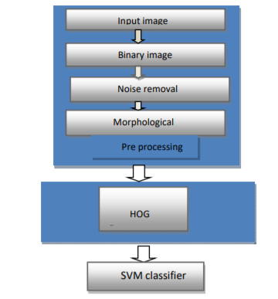
Paper 3: LAKSHMAN NAIKA R, R DINESH, ³SANTOSHNAIK. “HANDWRITTEN ELECTRONIC COMPONENTS RECOGNITION: AN APPROACH BASED ON HOG + SVM”. Journal of Theoretical and Applied Information Technology
The proposed method has following steps as shown in figure 1 i.e. preprocessing, feature extraction and classification.
In preprocessing, the scanned gray image is converted into binary level by adjusting threshold using Otsu’s approach .
Image is inverted so that back ground becomes black and objects into white using binary inversion technique .
For Feature extraction , Histogram of oriented gradient feature extraction technique(HOG) is used.

Slide 8
DATASET
Each component comprises of up to 100 hand drawn images.
A total of 5 components are recognized in the project.
The data set consists of 5 components i.e. inductor, resistor, diode, ground and voltage source.
Among the dataset of 100 images, each component has 80 images in the training set and 20 images in the test set.

Slide 9
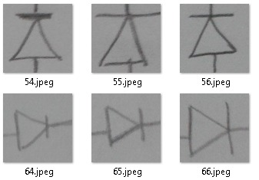
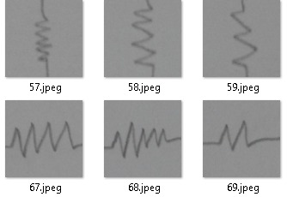
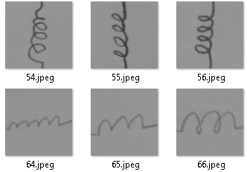
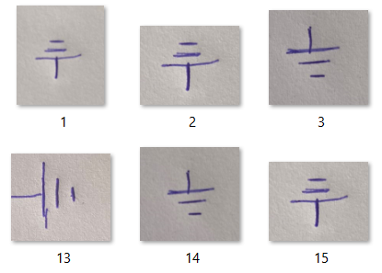
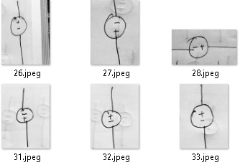
DIODE
RESISTOR
INDUCTOR
GROUND
VOLTAGE SOURCE

Slide 10
METHODOLOGY
IMAGE PREPROCESSING
Thresholding
Morphological operations (erosion, dilation)
Canny edge detection
Removal of lines
Contour detection
Bounding rectangles
K means clustering
Segmentation

Slide 11
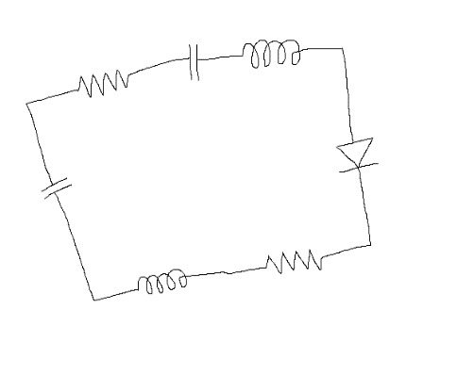
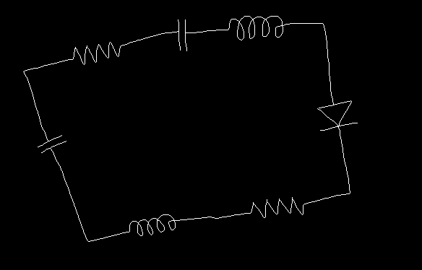
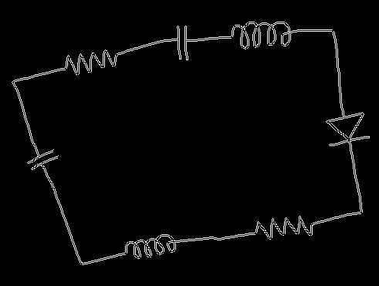
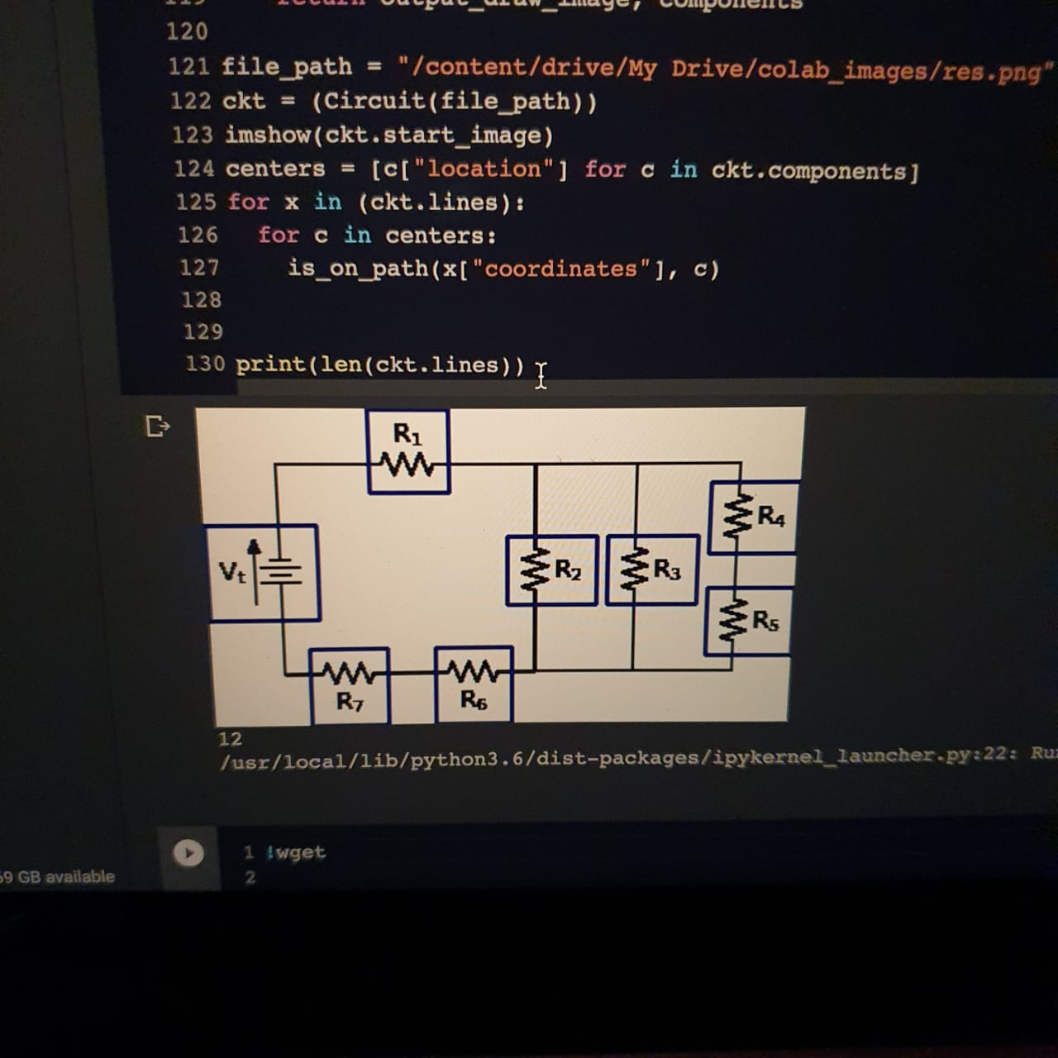

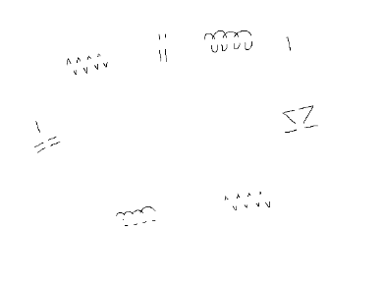
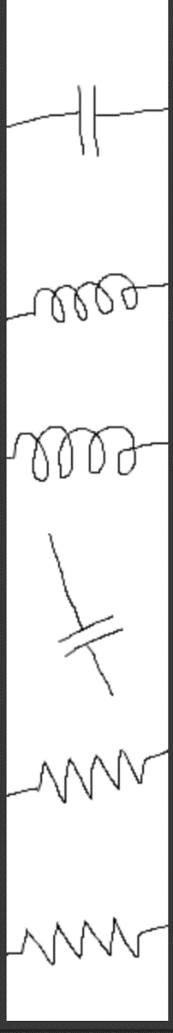
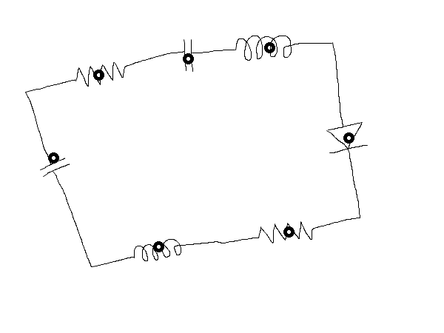
THRESHOLDING
MORPHOLOGICAL OPERATIONS
CANNY EDGE DETECTION
BOUNDING RECTANGLES
CONTOUR DETECTION
REMOVAL OF LINES
K MEANS CLUSTERING
SEGMENTATION

Slide 12
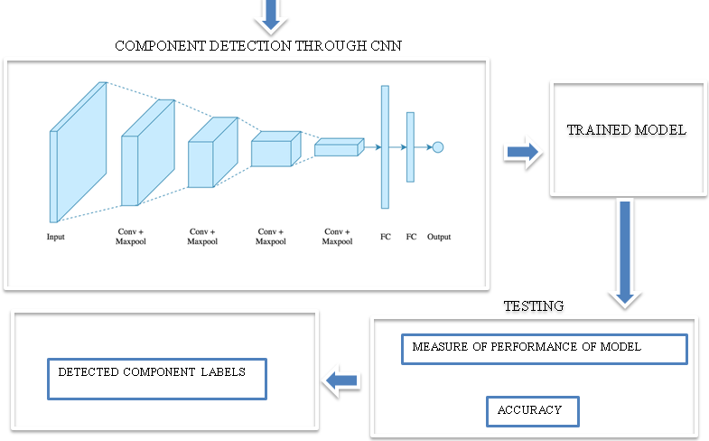
CLASSIFICATION
The output images from the circuit image are fed to a Convolutional Neural Network (CNN) model which will classify the components
We added the convolution layer with 32 feature detectors of 3x3 size and we used the Relu activation function.
We added a MaxPooling layer with a pool size of 2x2.
We added two more layers of convolution and pooling layers and then we used the flattened function.
Full Connection part is done after this, where we add Dense function along with activation function as Softmax.

Slide 13
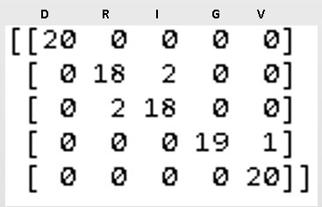
RESULTS
D
R
I
G
V
This is the Confusion Matrix on the test images.
For resistors, it gave two false negative predictions.
For Inductors, it gave two false positive predictions.
For Voltage source, it gave a false negative prediction.
The accuracy of the classification model was found to be 82%.
We combined the pre-processing step and the classification step and we were able to get the component images with their labels.
We considered 4-5 circuits for segmentation and classification

Slide 14
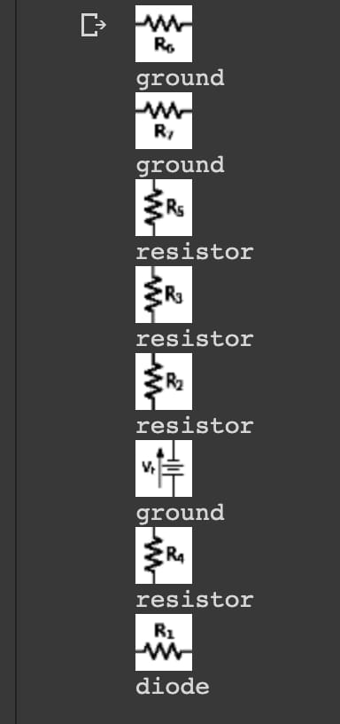
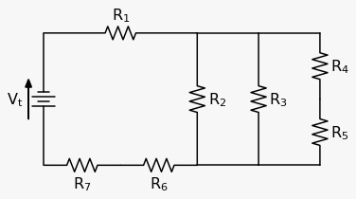
OUTPUT
INPUT CIRCUIT

Slide 15
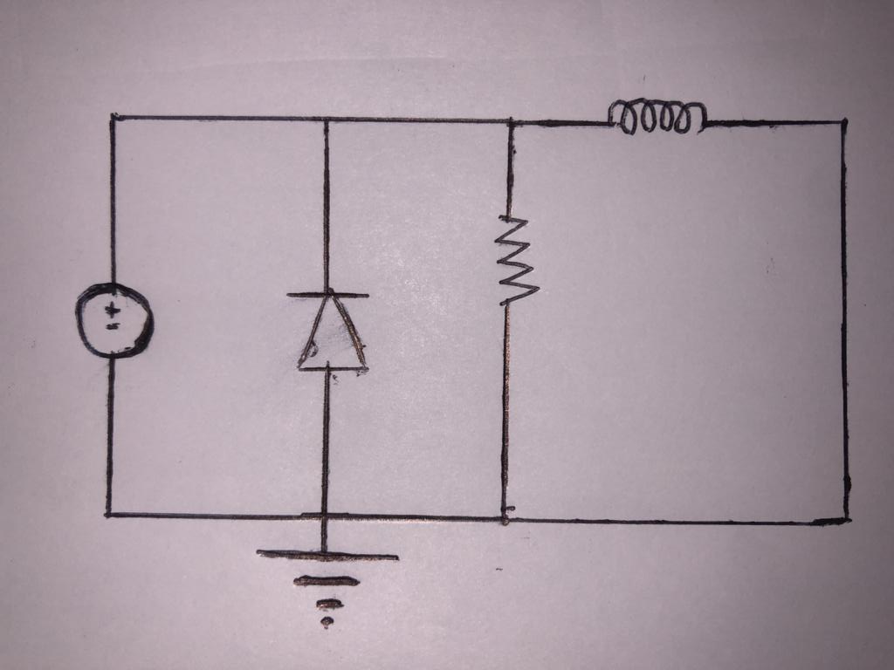
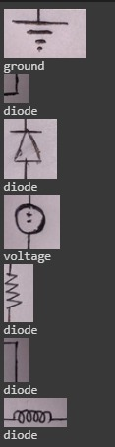
INPUT CIRCUIT
OUTPUT

Slide 16
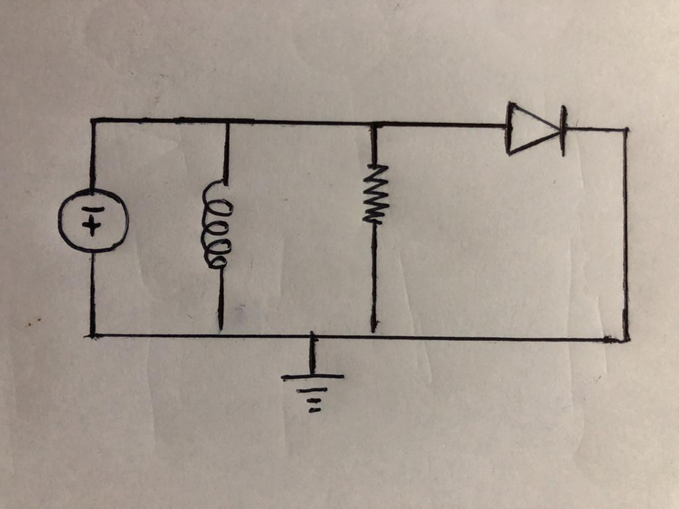
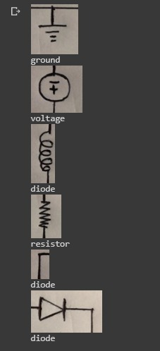
INPUT CIRCUIT
OUTPUT

Slide 17
FUTURE WORK
To improve accuracy of the CNN model.
Recognition of more components.
Develop a platform to perform simulations on circuits.
Identification of different types of circuits.
Use CNN for extraction of the components from the circuit.

Slide 18
REFERENCES
Mahdi Rabbani, Reza Khoshkangini, H.S.Nagendraswamy, Mauro Conti “Hand Drawn Optical Circuit Recognition”. 7th International Conference on Intelligent Human Computer Interaction, IHCI 2015.
Lakshman Naika R, Dinesh R, and Prabhanjan S “Handwritten Electric Circuit Diagram Recognition: An Approach Based on Finite State Machine” International Journal of Machine Learning and Computing, Vol. 9, No. 3, June 2019
Srikant Sridar and Krishnan Subramanian “Circuit Recognition using Netlist”. Proceedings of the 2013 IEEE Second International Conference on Image Information Processing (ICIIP-2013)
Shriram K. Vasudevan, Karthik Venkatachalam, S. Anandaram and Anish J. Menon. “A Novel Method for Circuit Recognition Through Image Processing Techniques”. Medwell Journals,2016

